Slide 1
Potato Disease Prediction using CNN
GROUP 4

Slide 2
Libraries & Modules
Numpy and Pandas
Matplotlib
Tensorflow.keras.models import Sequential
tensorflow.keras.preprocessing.image import ImageDataGenerator
from tensorflow.keras.layers import Conv2D, MaxPooling2D, Flatten, Dense
from tensorflow.keras.preprocessing import image
for numerical computations
for data manipulation and analysis
For creating visualizations and show images
represents a linear stack of layers
used as layers in convolutional neural network CNN
used for real-time data augmentation and preprocessing of image data during training
provides functions for loading and manipulating images

Slide 3
Data Augumentation
generate batches of tensor image data with real-time data augmentation
datagen=ImageDataGenerator(rescale=1./255,rotation_range=30,horizontal_flip=True)
ImageDataGenerator generates batches of augmented image data
rescale=1./255 scales the pixel values of the images in the range [0, 255] to the range [0, 1]
rotation_range=30 specifies that the images can be randomly rotated by a maximum of 30 degrees during augmentation.
horizontal_flip=True indicates that the images can be horizontally flipped randomly during augmentation.
training_set=datagen.flow_from_directory(r"Project_Dataset\Training", target_size=(120,120), batch_size=300, class_mode='categorical')
test_set=datagen.flow_from_directory(r"Project_Dataset\Testing",target_size=(120,120),batch_size=300, class_mode='categorical')
target_size=(120, 120) specifies the size to which the images should be resized during preprocessing.
batch_size=300 determines the number of images to include in each batch.
class_mode='categorical' indicates that the labels for the images are categorical (one-hot encoded).
class_labels={0:"Early_Blight",1:"Healthy",2:"Late_Blight"}
class_labels is a dictionary that maps the class indices (0, 1, 2) to their corresponding class labels ("Early_Blight", "Healthy", "Late_Blight").

Slide 4
Model Architecture
model=Sequential()
model.add(Conv2D(32,(3,3), input_shape=(120,120,3)))
total parameters = (no of filters * parameters of filters)+bias for each filter
32 * (3*3*3) + 32 = 896
(118, 118, 32) => because 1 filter convoluting a 120x120 image produces a feature matrix of 118x118 so 32 such feature matrices
model.add(MaxPooling2D(2,2))
halves the image size w/o loss in information2,2 reduces the size of the image to half. the no of parameters is zero here because there is no learning happening in this step and it is just an operation.
model.add(Conv2D(64,(3,3)))
no of parameters here is 64 filters of size 3*3 applied to each feature map which are 32 in total and adding bias for each filter i.e. (64*3*3*32)+64=18496

Slide 5
Model Architecture
model.add(MaxPooling2D(2,2))
model.add(Conv2D(128,(3,3)))
(128*3*3*64)+128=73856
model.add(MaxPooling2D(2,2))
model.add(Flatten())
reshapes the feature maps into a 1D vector => 128*13*13=21632 size of the array
the no of parameters is zero here because there is no learning happening in this step and it is just an operation.
model.add(Dense(128,activation='relu'))
size of previous layer *size of current layer +bias of current layer => 21632*128+128=2769024
model.add(Dense(3,activation='softmax'))
size of previous layer *size of current layer +bias of current layer => 128*3+3=387
model.summary()

Slide 6
Model Compilation and Training
model.compile(optimizer='adam',loss='categorical_crossentropy', metrics=['accuracy'])
optimizer='adam' specifies the optimizer algorithm to be used during training.
loss='categorical_crossentropy' sets the loss function => suitable for multi-class classification problems where the labels are one-hot encoded.
metrics=['accuracy'] specifies the evaluation metric to be used => accuracy is chosen as the metric to monitor the model's performance.
model.fit(training_set,epochs=60,validation_data=test_set)
training_set is the data generator object that generates batches of training data.
epochs=60 indicates the number of times the model will iterate over the entire training dataset during training.
validation_data=test_set specifies the data generator object to be used for validation during training.
The model's performance on the validation set will be evaluated after each epoch.

Slide 7
Image Prediction
img = image.load_img(r"Project_Dataset\Validation\Early_Blight\Early_Blight_1.jpg",target_size=(120,120,3))
target_size=(120, 120, 3) specifies the size of the image => (120, 120) with 3 channels (RGB)
plt.imshow(img)
test_img=np.asarray(img)
Converts the image to a numpy array
test_img.shape
test_img=test_img.reshape(1,120,120,3)
test_img.reshape(1, 120, 120, 3) reshapes the array to have a batch dimension of 1, to match the expected
shape of the input data for the model.
yhat=model.predict(test_img)
yhat contains the predicted probabilities for each class
predicted_class = np.argmax(yhat[0])
np.argmax finds the index of the class with the highest probability.
predicted_class stores the index of the predicted class with the highest probability.
predicted_labels=class_labels[predicted_class]
class_labels is the dictionary which maps class indices to their corresponding labels.
predicted_label retrieves the predicted label from class_labels based on the predicted_class.
print("Predicted Label is: ",predicted_labels)

Slide 8
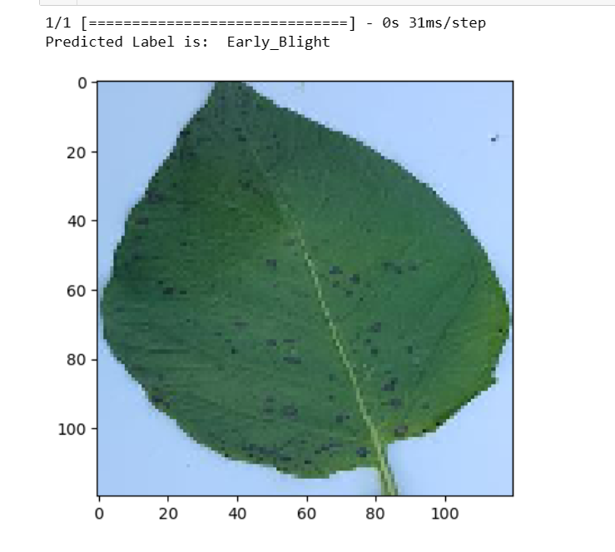
Prediction
Image of an early blight potato leaf
Predicted Label:
Early Blight

